Slide 1

Methodologies, methods &
units of analysis
Janet Salmons, PhD

Slide 2
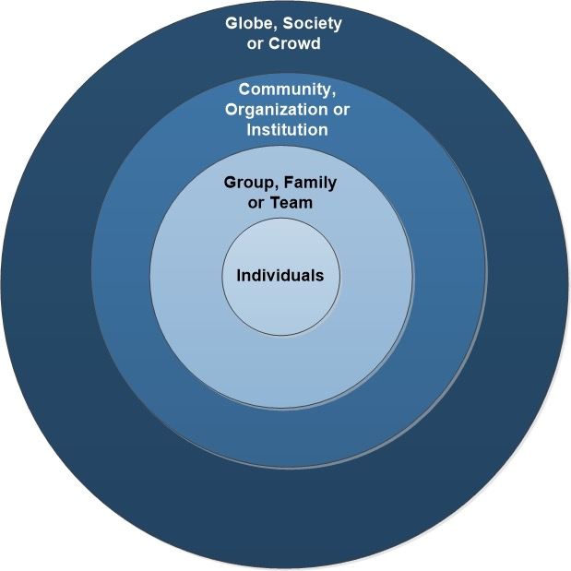
What is the scope of the study?

Slide 3
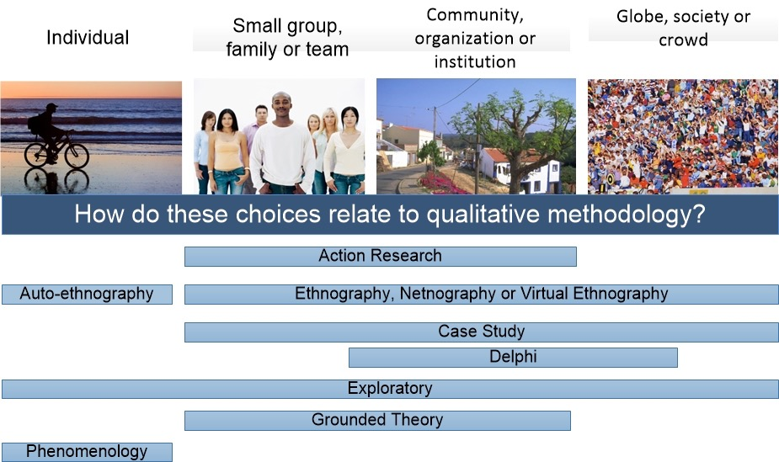
Units of analysis relate to the choice of methodology

Slide 4
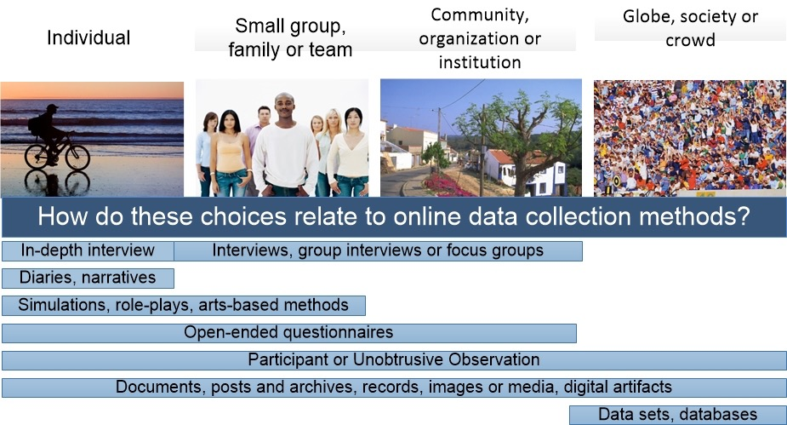
Units of analysis relate to the choice of methoD
Notes:
Again, there are not firm boundaries but some methods

